Slide 1
CHAPTER 6
Discrete Probability Distributions
to accompany
Introduction to Business Statistics
seventh edition, by Ronald M. Weiers
Presentation by Priscilla Chaffe-Stengel
Donald N. Stengel
© 2011 Cengage Learning.
All Rights Reserved. May not be scanned, copied, or duplicated, or posted to a publicly accessible website, in whole or in part.

Slide 2
Chapter 6 - Learning Objectives
Distinguish between discrete and continuous random variables.
Differentiate among the binomial, the hypergeometric, and the Poisson discrete probability distributions and their applications.
Apply the Bernoulli process to consecutive trials associated with the binomial distribution.
Use the appropriate probability distribution in determining the probability a discrete random variable will have a given value or value in a given range.
        © 2011 Cengage Learning.
        All Rights Reserved. May not be scanned, copied, duplicated, or posted to a publicly accessible website, in whole or in part.

Slide 3
Chapter 6 - Key Terms
Random variables
  Discrete
  Continuous
Bernoulli process
Probability distributions
  Binomial distribution
  Hypergeometric distribution
  Poisson distribution
        © 2011 Cengage Learning.
        All Rights Reserved. May not be scanned, copied, duplicated, or posted to a publicly accessible website, in whole or in part.

Slide 4
Discrete vs Continuous Variables
Discrete Variables: Can take on only certain values along an interval
  the number of sales made in a week
  the volume of milk bought at a store
  the number of defective parts
Continuous Variables: Can take on any value at any point along an interval
  the depth at which a drilling team strikes oil
  the volume of milk produced by a cow
  the proportion of defective parts
        © 2011 Cengage Learning.
        All Rights Reserved. May not be scanned, copied, duplicated, or posted to a publicly accessible website, in whole or in part.

Slide 5
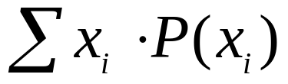
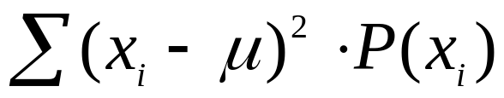
Describing the Distribution for a Discrete Random Variable
The probability distribution for a discrete random variable defines the probability of a discrete value x.
  Mean: µ = E(x) =
  Variance: σ² = E[(x – µ)²]
  =
        © 2011 Cengage Learning.
        All Rights Reserved. May not be scanned, copied, duplicated, or posted to a publicly accessible website, in whole or in part.

Slide 6
The Bernoulli Process,
Characteristics
There are two or more consecutive trials.
In each trial, there are just two possible outcomes.
The trials are statistically independent.
The probability of success remains constant trial-to-trial.
        © 2011 Cengage Learning.
        All Rights Reserved. May not be scanned, copied, duplicated, or posted to a publicly accessible website, in whole or in part.

Slide 7
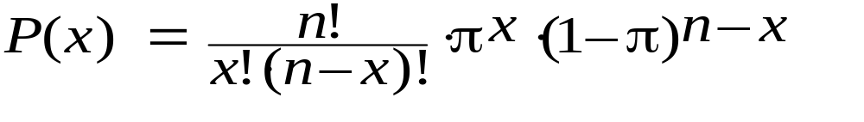
The Binomial Distribution
The binomial probability distribution defines the probability of exactly x successes in n trials of the Bernoulli process.
  for each value of x.
  Mean: µ = E(x) = n π
  Variance: σ² = E[(x – µ)²] = n π (1 – π)
        © 2011 Cengage Learning.
        All Rights Reserved. May not be scanned, copied, duplicated, or posted to a publicly accessible website, in whole or in part.

Slide 8
The Binomial Distribution,
An Example Worked with Tables
Example, Problem 6.22: According to the National Marine Manufacturers Association, 50.0% of the population of Vermont were boating participants during the most recent year. For a randomly selected sample of 20 Vermont residents, with x = the number sampled who were boating participants that year, determine:
a. E(x) = n π = 20 x 0.50 = 10
b. P(x ≤ 8) Go to Appendix, Table A.2, n = 20. For π = 0.5
and k = 8, P(x ≤ 8) = 0.2517
c. P(x = 10) Go to Appendix, Table A.1, n = 20. For π = 0.5
and k = 10, P(x = 10) = 0.1762
        © 2011 Cengage Learning.
        All Rights Reserved. May not be scanned, copied, duplicated, or posted to a publicly accessible website, in whole or in part.

Slide 9
The Binomial Distribution,
An Example Worked with Tables
Example, Problem 6.22 : According to a corporate association, 50.0% of the population of Vermont were boating participants during the most recent year. For a randomly selected sample of 20 Vermont residents, with x = the number sampled who were boating participants that year, determine:
d. P(x = 12) Go to Appendix, Table A.1, n = 20. For π = 0.5
and k = 12, P(x = 12) = 0.1201
e. P(7 ≤ x ≤ 13) Go to Appendix, Table A.2, n = 20.
For π = 0.5 and k = 13, P(x ≤ 13) = 0.9423
For π = 0.5 and k = 6, P(x ≤ 6) = 0.0577
P(7 ≤ x ≤ 13) = 0.9423 – 0.0577 = 0.8846
        © 2011 Cengage Learning.
        All Rights Reserved. May not be scanned, copied, duplicated, or posted to a publicly accessible website, in whole or in part.

Slide 10
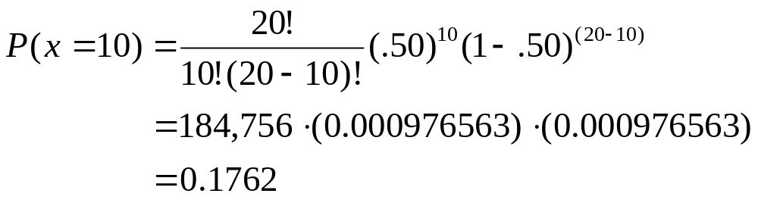
The Binomial Distribution,
An Example Worked with Equations
Example, Problem 6.22: According to the National Marine Manufacturers Association, 50.0% of the population of Vermont were boating participants during the most recent year. For a randomly selected sample of 20 Vermont residents, with x = the number sampled who were boating participants that year, determine:
c. P(x = 10)
        © 2011 Cengage Learning.
        All Rights Reserved. May not be scanned, copied, duplicated, or posted to a publicly accessible website, in whole or in part.

Slide 11
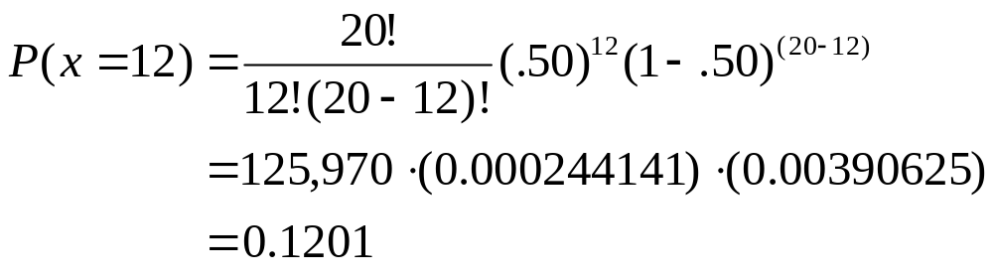
The Binomial Distribution,
An Example Worked with Equations
Example, Problem 6.22: According to the National Marine Manufacturers Association, 50.0% of the population of Vermont were boating participants during the most recent year. For a randomly selected sample of 20 Vermont residents, with x = the number sampled who were boating participants that year, determine:
d. P(x = 12)
        © 2011 Cengage Learning.
        All Rights Reserved. May not be scanned, copied, duplicated, or posted to a publicly accessible website, in whole or in part.

Slide 12
The Binomial Distribution,
An Example Worked with Excel
Problem 6.22: According to a corporate association, 50.0% of the population of Vermont were boating participants during the most recent year. For a randomly selected sample of 20 Vermont residents, with x = the number sampled who were boating participants that year, determine:
b. P(x ≤ 8) In a cell on an Excel worksheet, type
=BINOMDIST(8,20,0.5,true)
and you will see the answer: 0.2517
c. P(x = 10) In a cell on an Excel worksheet, type
=BINOMDIST(10,20,0.5,false)
and you will see the answer: = 0.1762
        © 2011 Cengage Learning.
        All Rights Reserved. May not be scanned, copied, duplicated, or posted to a publicly accessible website, in whole or in part.

Slide 13
The Binomial Distribution,
An Example Worked with Excel
Problem 6.22: According to a corporate association, 50.0% of the population of Vermont were boating participants during the most recent year. For a randomly selected sample of 20 Vermont residents, with x = the number sampled who were boating participants that year, determine:
d. P(x = 12) In a cell on an Excel worksheet, type
=BINOMDIST(12,20,0.5,false)
and you will see the answer: = 0.1201
e. P(7 ≤ x ≤ 13) In a cell on an Excel worksheet, type
=BINOMDIST(13,20,0.5,true)- BINOMDIST(6,20,0.5,true)
and you will see the answer: = 0.8846
        © 2011 Cengage Learning.
        All Rights Reserved. May not be scanned, copied, duplicated, or posted to a publicly accessible website, in whole or in part.

Slide 14
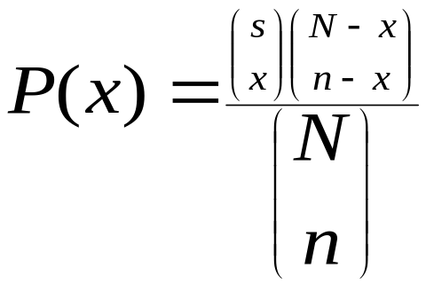
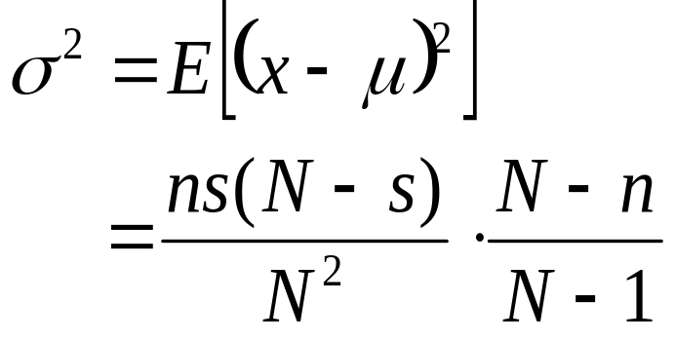
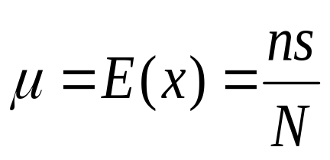
The Hypergeometric Distribution
The Hypergeometric distribution defines the probability of x successes in n trials from a small population of N elements, where sampling is conducted without replacement.
  - Variance:
  Mean :
        © 2011 Cengage Learning.
        All Rights Reserved. May not be scanned, copied, duplicated, or posted to a publicly accessible website, in whole or in part.

Slide 15
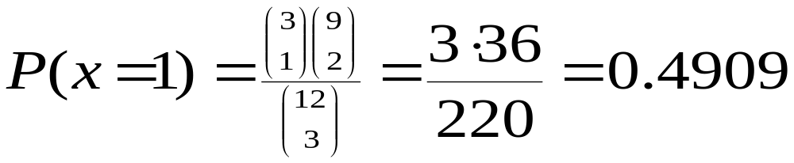
The Hypergeometric Distribution,
An Example Worked with Equations
Example, Problem 6.38: Unknown to a rental car office, 3 of the 12 subcompact models now available for rental are subject to a safety recall soon to be announced by the National Highway Traffic Safety Administration. Five subcompacts will be rented today, and the cars will be randomly selected from those available in the pool.
  What is the probability that exactly one of the recall-affected cars will be rented today?
        © 2011 Cengage Learning.
        All Rights Reserved. May not be scanned, copied, duplicated, or posted to a publicly accessible website, in whole or in part.

Slide 16
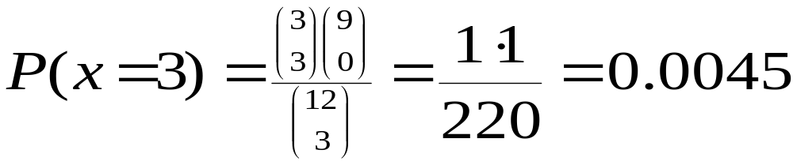
The Hypergeometric Distribution,
An Example Worked with Equations
Example, Problem 6.38: Unknown to a rental car office, 3 of the 12 subcompact models now available for rental are subject to a safety recall soon to be announced by the National Highway Traffic Safety Administration. Five subcompacts will be rented today, and the cars will be randomly selected from those available in the pool.
  What is the probability that all three of the recall-affected cars will be rented today?
        © 2011 Cengage Learning.
        All Rights Reserved. May not be scanned, copied, duplicated, or posted to a publicly accessible website, in whole or in part.

Slide 17
The Hypergeometric Distribution,
An Example Worked with Excel
Example, Problem 6.38: Unknown to a rental car office, 3 of the 12 subcompact models now available for rental are subject to a safety recall soon to be announced by the National Highway Traffic Safety Administration. Five subcompacts will be rented today, and the cars will be randomly selected from those available in the pool.
  What is the probability that exactly one of the recall-affected cars will be rented today?
In a cell on an Excel worksheet, type
=HYPGEOMDIST(1,3,3,12)
and you will see the answer: = 0.4909
        © 2011 Cengage Learning.
        All Rights Reserved. May not be scanned, copied, duplicated, or posted to a publicly accessible website, in whole or in part.

Slide 18
The Hypergeometric Distribution,
An Example Worked with Excel
Example, Problem 6.38: Unknown to a rental car office, 3 of the 12 subcompact models now available for rental are subject to a safety recall soon to be announced by the National Highway Traffic Safety Administration. Five subcompacts will be rented today, and the cars will be randomly selected from those available in the pool.
  What is the probability that all three of the recall-affected cars will be rented today?
In a cell on an Excel worksheet, type
=HYPGEOMDIST(3,3,3,12)
and you will see the answer: = 0.0045
        © 2011 Cengage Learning.
        All Rights Reserved. May not be scanned, copied, duplicated, or posted to a publicly accessible website, in whole or in part.

Slide 19
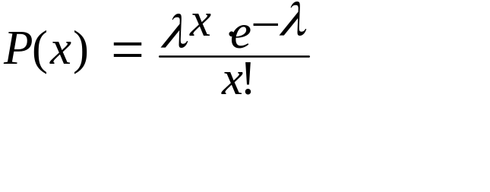
The Poisson Distribution
The Poisson distribution defines the probability that an event will occur exactly x times over a given span of time, space, or distance.
  where λ = the mean number of occurrences over the span
  e = 2.71828, a constant
  Mean = Variance = λ
  Example, Problem 6.44: During the 12 p.m. – 1 p.m. noon hour, arrivals at a curbside banking machine have been found to be Poisson distributed with a mean of 1.3 persons per minute. If x = number of arrivals per minute, determine:
  a. E(x) = λ = 1.3
        © 2011 Cengage Learning.
        All Rights Reserved. May not be scanned, copied, duplicated, or posted to a publicly accessible website, in whole or in part.

Slide 20
The Poisson Distribution,
An Example Worked with Tables
Example, Problem 6.44: During the 12 p.m. – 1 p.m. noon hour, arrivals at a curbside banking machine have been found to be Poisson distributed with a mean of 1.3 persons per minute. If x = number of arrivals per minute, determine:
  b. P(x = 0) = 0.2725 from Appendix Table A.3, λ = 1.3, k = 0
  c. P(x = 1) = 0.3543 from Appendix Table A.3, λ = 1.3, k = 1
  d. P(x ≤ 2) = 0.8571 from Appendix Table A.4, λ = 1.3, k = 2
  e. P(1 ≤ x ≤ 3) = 0.9569 – 0.2725 = 0.6844 from
  Table A.4, λ = 1.3, k = 3 and k = 0
        © 2011 Cengage Learning.
        All Rights Reserved. May not be scanned, copied, duplicated, or posted to a publicly accessible website, in whole or in part.

Slide 21
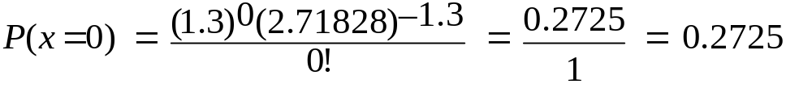
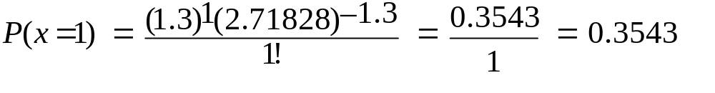
The Poisson Distribution,
An Example Worked with Equations
Example, Problem 6.44: During the 12 p.m. – 1 p.m. noon hour, arrivals at a curbside banking machine have been found to be Poisson distributed with a mean of 1.3 persons per minute. If x = number of arrivals per minute, determine:
  b.
  c.
  d. P(x ≤ 2) = 0.8571 from Appendix Table A.4, λ = 1.3, k = 2
  e. P(1 ≤ x ≤ 3) = 0.9569 – 0.2725 = 0.6844 from
  Table A.4, λ = 1.3, k = 3 and k = 0
        © 2011 Cengage Learning.
        All Rights Reserved. May not be scanned, copied, duplicated, or posted to a publicly accessible website, in whole or in part.

Slide 22
The Poisson Distribution,
An Example Worked with Excel
Example, Problem 6.44:
  b. P(x = 0) In a cell in an Excel spreadsheet, type
=POISSON(0,1.3,false)
and you will see the answer: = 0.2725
  c. P(x = 1) In a cell in an Excel spreadsheet, type
=POISSON(1,1.3,false)
and you will see the answer: = 0.3543
  d. P(x ≤ 2) In a cell in an Excel spreadsheet, type
=POISSON(2,1.3,true)
and you will see the answer: = 0.8571
  e. P(1 ≤ x ≤ 3) In a cell in an Excel spreadsheet, type
=POISSON(3,1.3,true)-POISSON(0,1.3,true)
and you will see the answer: = 0.6844
        © 2011 Cengage Learning.
        All Rights Reserved. May not be scanned, copied, duplicated, or posted to a publicly accessible website, in whole or in part.

